Slide 1
PREVENT. PROTECT.
Notes:
Cover Page 1 – Please delete if not being used. Use the same slide for the thank you slide at the end of the presentation with the disclaimer. Suitable for all presentations focussing on road transport.

Slide 2
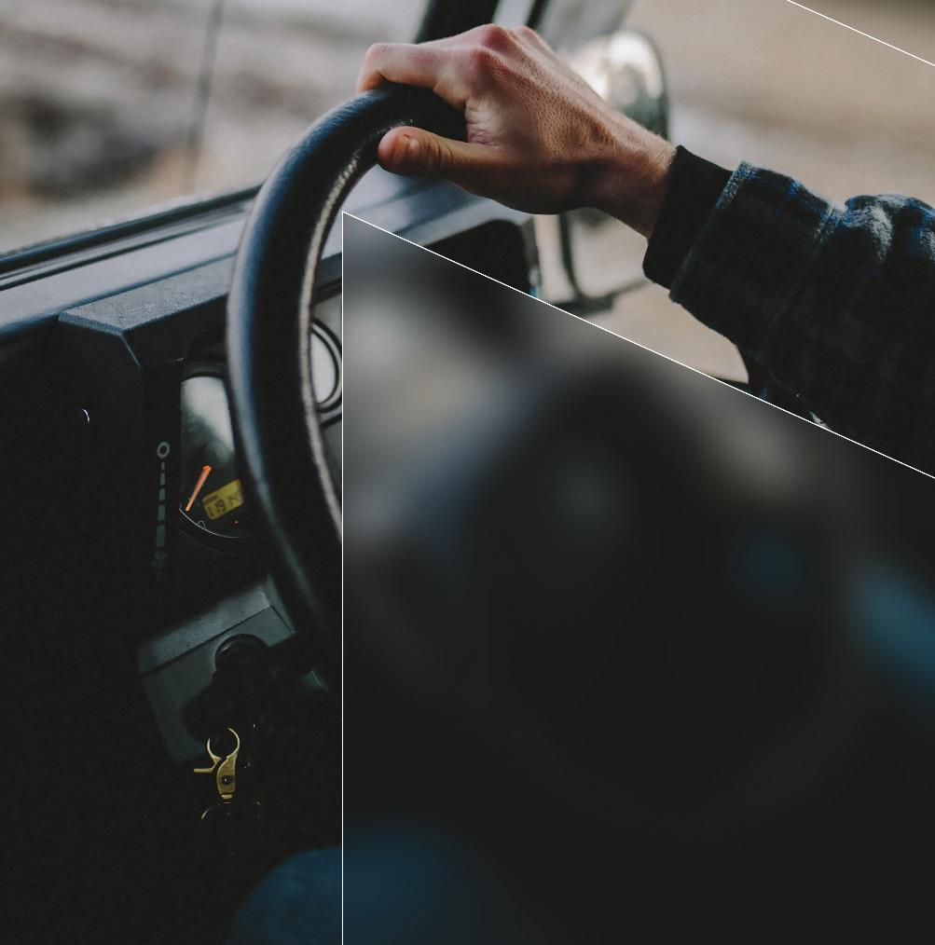
Prevent. Protect.
Real-time driver fatigue and distraction accident prevention solution.
Intervened in more than 100,000 fatigue events in the past 12 months.
Adopted by more than 300 transport & logistics companies across the globe.
Proven technology based upon almost 20 years of research.
MORE THAN
4.5 MILLION
EVENTS DETECTED TO DATE
MORE THAN
100,000
CLASSIFIED DISTRACTION EVENTS (12 MONTHS)
DETECTED
SCIENTIFICALLY PROVEN TO
REDUCE FATIGUE
EVENTS BY MORE THAN
90%

Slide 3



Prevent Deadly Behaviours
Of road transport worker fatalities happened whilst driving a truck.
Example: 4000 workers injured each year in the road freight sector.
58%
Example: 80 workers are killed each year working in or around a truck.
73%
Of truck related fatalities occurred on public roads.
Example: Road Transport workers are 12-15 times more likely to be killed at work than any other worker.
5%
Of injuries occurred as a result of being hit by a vehicle.
Notes:
Adjust graphics to suit your statistic.

Slide 4
ABOUT US
Notes:
Cover page 2 – Please delete if not in use. Use the same slide for the thank you slide at the end of the presentation with the disclaimer. Suitable for all presentation on road transport.

Slide 5
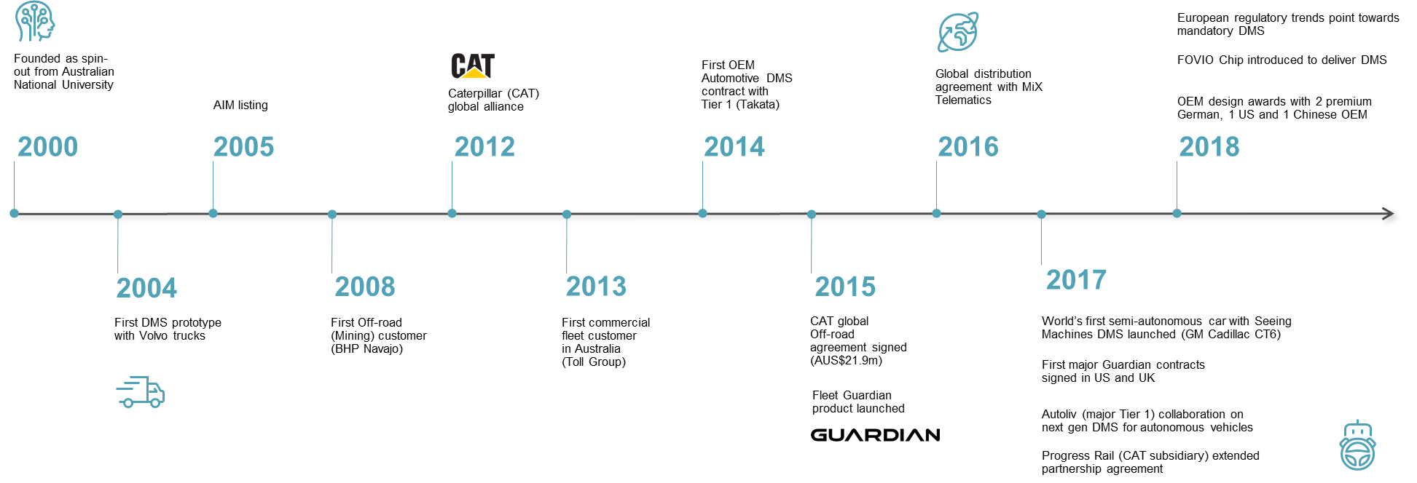
Our history
Notes:
Body Slide 2 - Please keep text and images within the light grey space. Please use font and colour scheme that is built into the template.

Slide 6
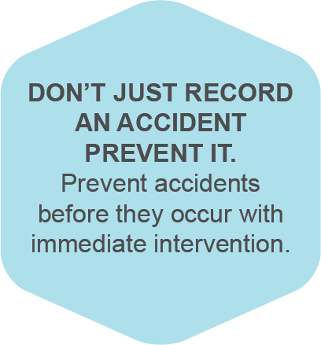
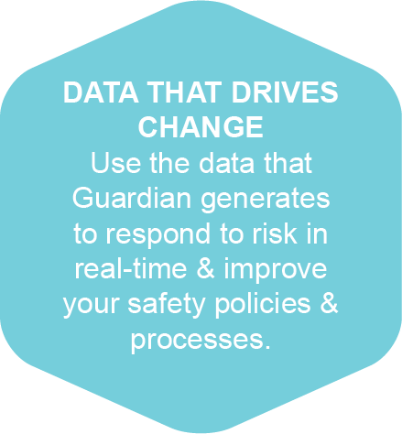

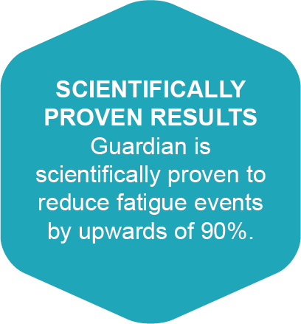

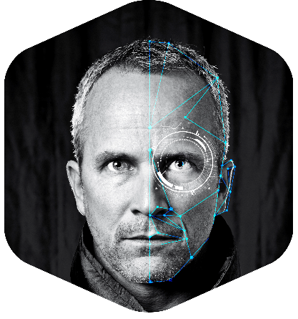
The Guardian Difference

Slide 7

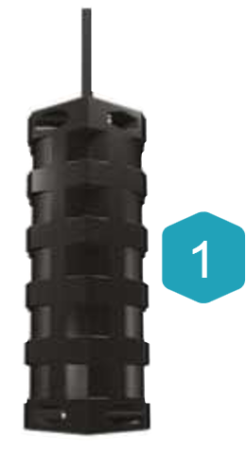
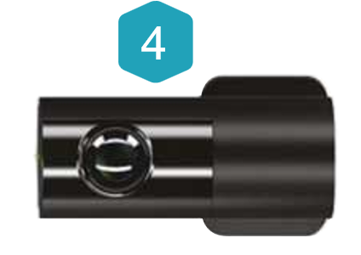


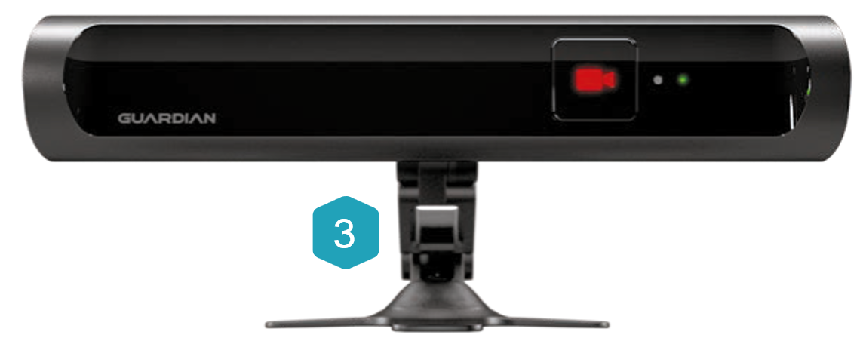
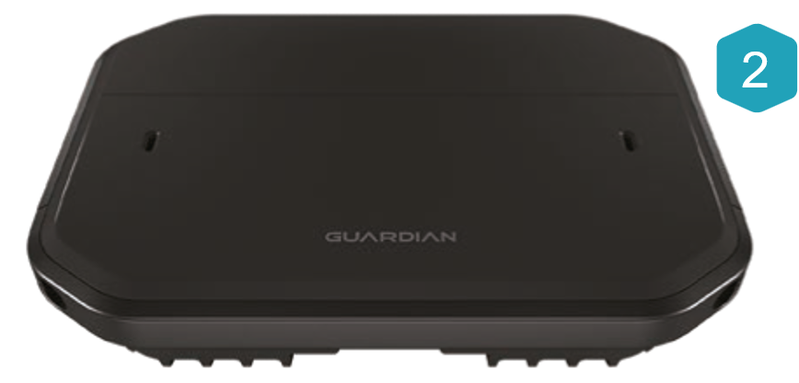

GEN 2 HARDWARE COMPONENTS
Vibration motor
Processor
In-cab guardian sensor
Forward-facing camera

Slide 8
HOW IT WORKS
Notes:
Cover page 4 – Suitable for all trucking presentations. Use the same slide for the thank you slide at the end of the presentation with the disclaimer. Please delete if not in use.

Slide 9
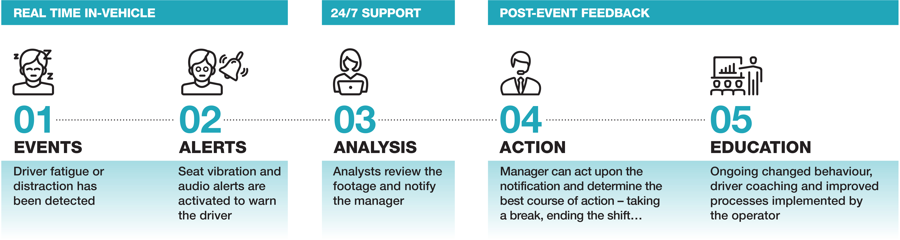
How it works
Real-time fatigue & distraction detection
Real-time in-cab alerts (audio/vibration)
Real-time fatigue & distraction event validation
Real-time intervention within minutes

Slide 10

Fatigue Intervention
Note: These videos are not for redistribution in any form.
Notes:
U.S. Example

Slide 11

Fatigue Intervention
Note: These videos are not for redistribution in any form.
Notes:
U.S. Example

Slide 12

Distraction Intervention
Note: These videos are not for redistribution in any form.
Notes:
APAC Example

Slide 13
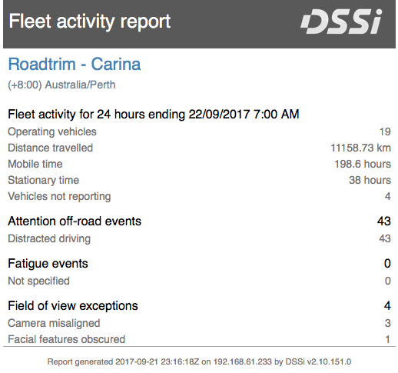



Daily & Weekly Reports
Daily & weekly reports provide data on:
Events by day
Driver behaviour performance by vehicle
No. of events by hour of day
Duration/speed of events
Events by GPS location
Field of view exceptions
Diagnostic Data

Slide 14
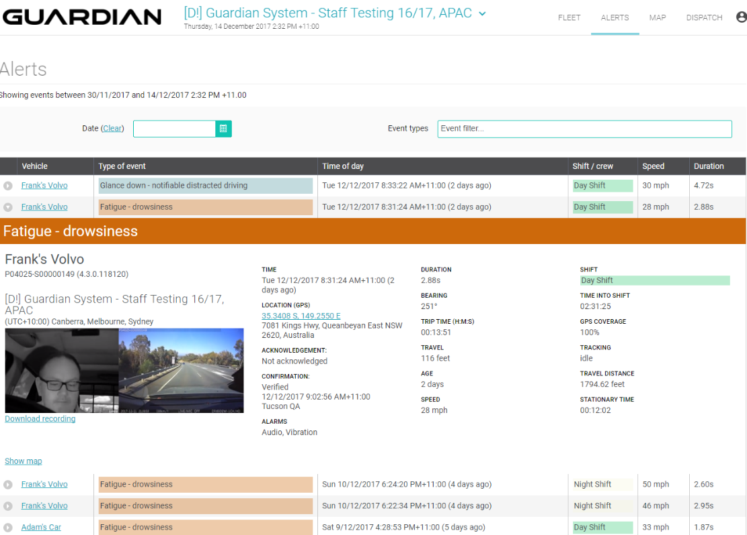
Guardian Live
Discover more about your drivers behaviour by looking into individual events:
Time & Date of event
Location
Speed
Distance travelled
Duration
Duration in trip since departure
Driver facing & forward facing footage

Slide 15




Message Queue
Display Guardian data in your telematics provider’s interface with our secure message queue service.
Telematics Data
Telematics providers database
Telematics Data
Guardian event data
Have direct access to data through Guardian Live & telematics data via your telematics providers website.
SM database
Event confirmed at 24/7 Guardian Center
Messages are received & URL provided for media retrieval
Client database

Slide 16

The Research
BACKGROUND
The paper evaluates the impact of real-time alerts in reducing fatigue events in long haul vehicles, using Guardian.
3 long haul trucking companies in South Africa are examined. 49 trucks were examined in total over a 5 month period.
In the observation period no alerts were activated however data was recorded when the driver experienced a fatigue event.
In the intervention period, when the technology detected a fatigue event, real-time alerts were provided to the driver and employer.

Slide 17
Key Results
90%
x11
90%
Using Guardian’s real-time alerts, long haul fleets can reduce fatigue events by upwards of 90%.
Fatigue events occurred 11 times higher in the observation period on a per distance travelled rate.
For the number of operating days, the time spent in vehicle, and distance travelled there was a reduction in fatigue by more than 90%

Slide 18
Scientifically Proven Results
93.6%
Reduction in fatigue events
93.2%
Reduction in fatigue events

Slide 19
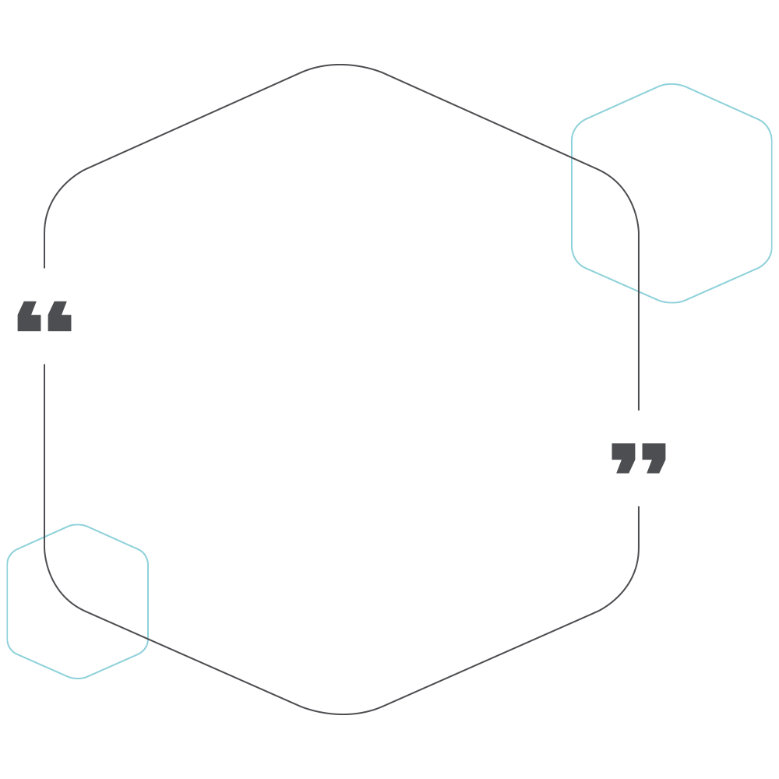
Case Studies
We have tried and tested a vast product range of driver camera systems but none were sufficient with regards to a pro-active solution for driver fatigue, until we found Guardian.
Phoenix K9 Security
Since we have implemented the Guardian System, it has reduced our fatigue risk dramatically.
Loutrans

Slide 20
Thank you
Notes:
Thank you/disclaimer slide.

